Slide 1


KS2 Maths and English workshop
Monday 10th November 2025
Session 1: 6:00 – 6:20
(Fraction calculating)
Session 2: 6:20 – 6:40
(Fraction calculating)
Session 3: 6:40 – 7:00
(BIDMAS-the order of operations)

Slide 2
KS2 Curriculum
Curriculum calendars can be found on school website:
Mathematics - Walkwood Church of England Middle School

Slide 3
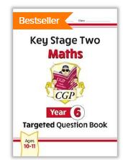

Useful websites and books
Home - MyMaths
CGP
Letts
Collins
WHSmith
Rising Stars

Slide 4
Adding and Subtracting Fractions

Slide 5
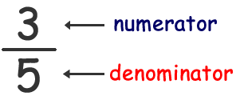
Add and Subtract Fractions
Key fact
You can only do this when the denominator is the SAME.

Slide 6

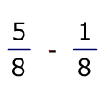
Same Denominator
⅜ + ⅛
⅗ + ⅘

Slide 7
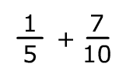
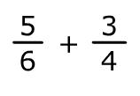

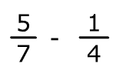
Different Denominator

Slide 8
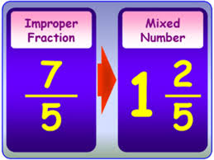
Improper/Mixed Number Fractions

Slide 9


Mixed number fractions

Slide 10
Multiplying and dividing Fractions

Slide 11
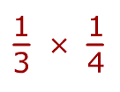
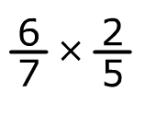

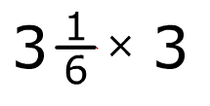
Multiplying fractions
X 3

Slide 12

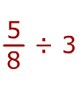
Dividing fractions

Slide 13
Mymaths.co.uk
Login- walkwood
Password- multiply
Select Number then Fractions:
Adding and subtracting fractions lesson
Improper and mixed fractions
Starting to multiply fractions
Multiplying fractions by fractions
Multiply divide fractions intro
Multiplying fractions

Slide 14
Questions?

